Slide 1
How to use IoT and Win a trip to China! (almost)
Harold Pulcher
pulcher@pulcher.biz
@haroldpulcher
https://www.youtube.com/user/hpulcher
https://github.com/pulcher/mkr1000_challenge

Slide 2


Become a Windows Insider!
https://insider.windows.com/

Slide 3
Step 1
Get an account on hackster.io

Slide 4

Step 2
Enter a contest!

Slide 5
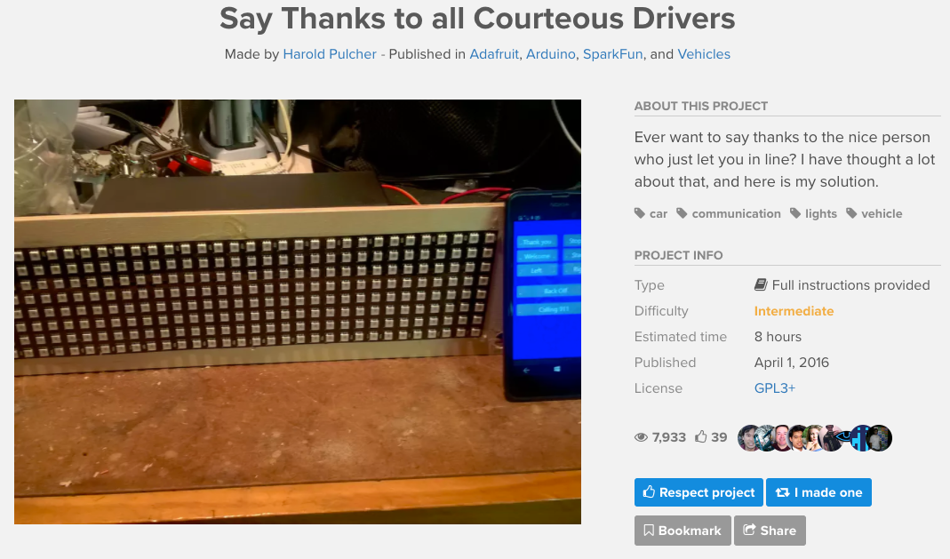
Step 3
Complete your project!

Slide 6
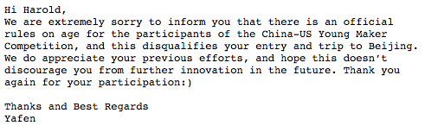
Step 4
WIN!
(Almost)

Slide 7
Seriously, lets talk about this project.

Slide 8
What was the spark?

Slide 9
Here was my idea….

Slide 10
Tell me what I need!
MKR1000
Arduino IDE
Bluetooth Modem
Logic level converter
DotStar matrix
Power Adapter
Virtual Shield?
and a case of some sort.

Slide 11
MKR1000
SAMD32 Cortex-M0+32Bit low power ARM MCU
Li-Po single cell battery & charger
3.3V
8 Digital IO
12 PWM
1 UART
1 SPI
1 I2C
7 Analog input
1 Analog output
256KB Flash memory
https://store.arduino.cc/usa/arduino-mkr1000

Slide 12
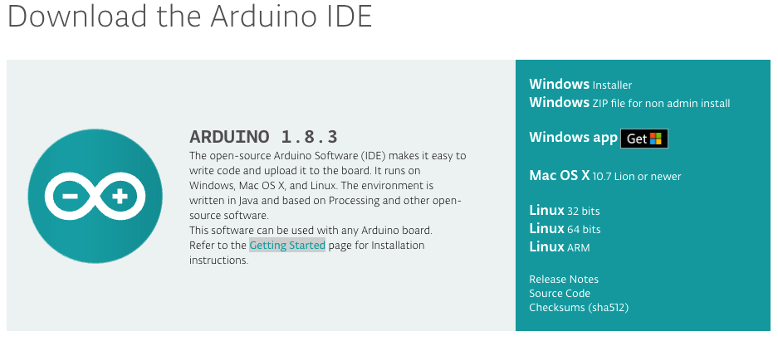
https://www.arduino.cc/en/Main/Software

Slide 13
Bluetooth modem
FCC Approved Class 2 bluetooth Radio Modem
Operates in harsh RG environments, ie Wifi, 802.11agn(etc)
Accepts 3.3V - 6V
Serial Communications: 2400-115200bps
Built-in antenna
Easily get 20M(65.62’)
https://www.hackster.io/sparkfun/products/sparkfun-bluetooth-modem-bluesmirf-silver

Slide 14
DotStar Matrix
8 x 32 Addressable RGB LEDs
24-bit Color control
APA102C based
SPI Interface
Works like a “Shift” register
https://www.adafruit.com/product/2736

Slide 15
Power Adapter
So how much power do you need?

Slide 16
Virtual Shield?
Windows phone
Android?

Slide 17
Case of some sort….

Slide 18
Demo Time

Slide 19
Links
https://www.hackster.io/pulcher/say-thanks-to-all-courteous-drivers-a2387a
https://en.wikipedia.org/wiki/Serial_Peripheral_Interface_Bus

Slide 20
https://msdn.microsoft.com/en-us/library/windows/apps/xaml/windows.devices.gpio.aspx?f=255&MSPPError=-2147217396

